Slide 1

Camry Labs Pte Ltd
Case Study under Principle’s of Economics and Software Project Management
Innovative IT Solutions for Digital Transformation

Slide 2

Company Overview
Name: Camry Labs Private Limited
Type: Private Limited, Unlisted, Active
Industry: Computer programming, consultancy
solutions and related IT services
Registered Office Address: 31/2, North Main Road, Koregaon Park,
Pune, Maharashtra 411001

Slide 3

Company Size and Financial Snapshot
Incorporation Date: 26 Feb 2024
Company Age: ~1.5 Years
Employees: Upto 100
Revenue: Not publicly disclosed

Slide 4
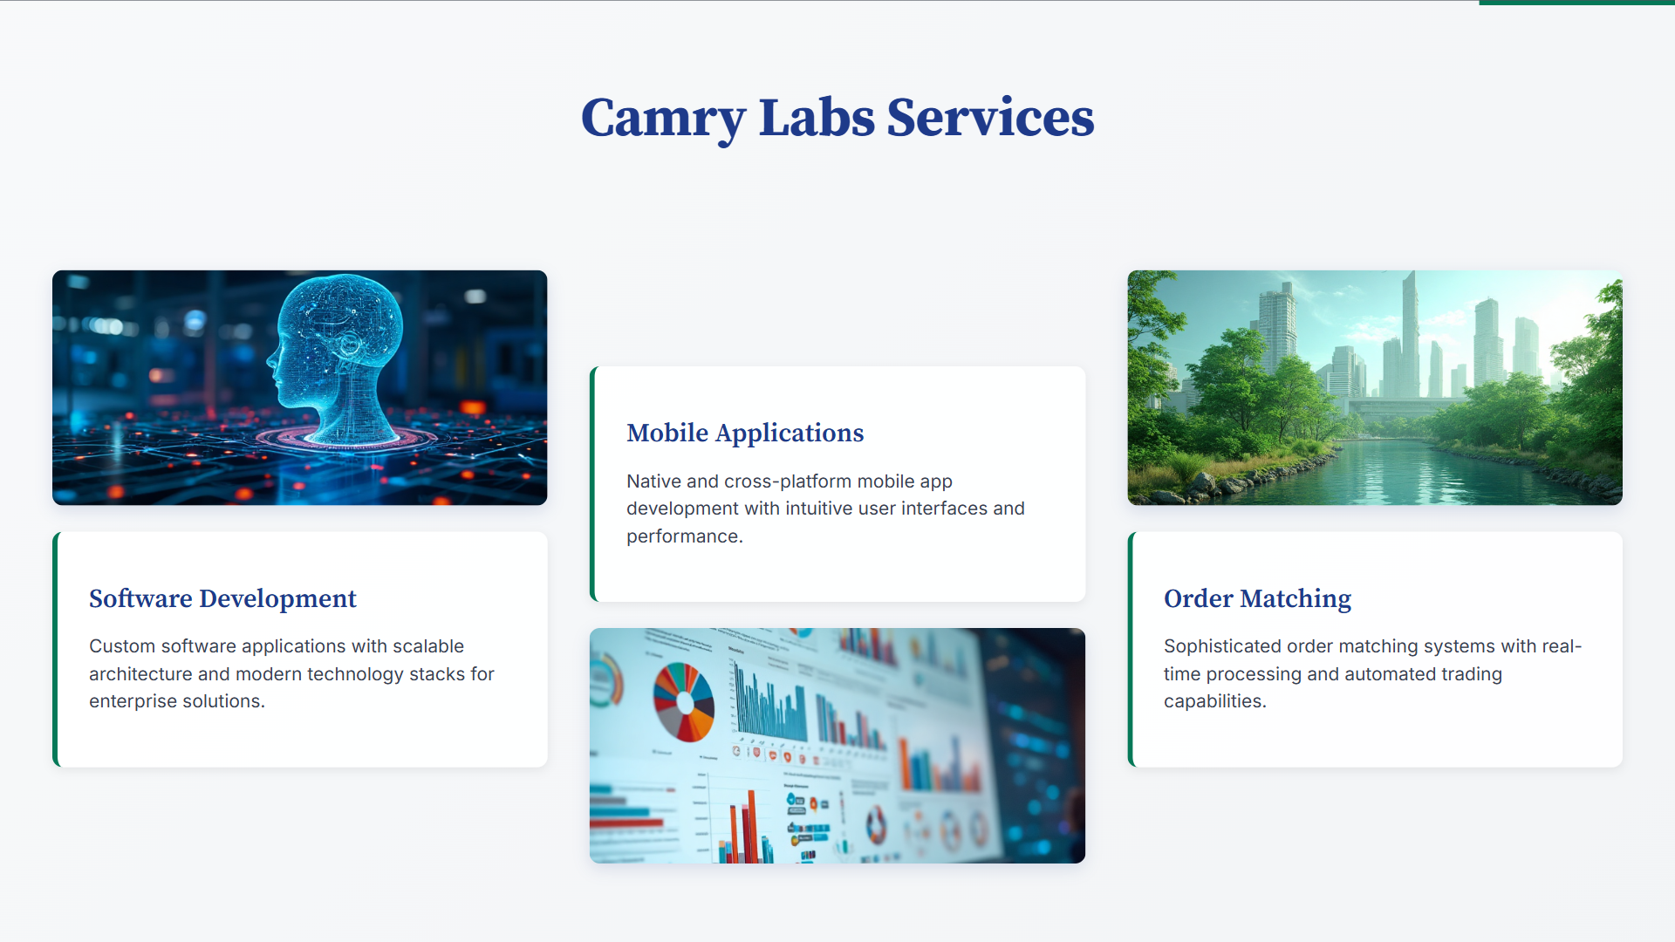
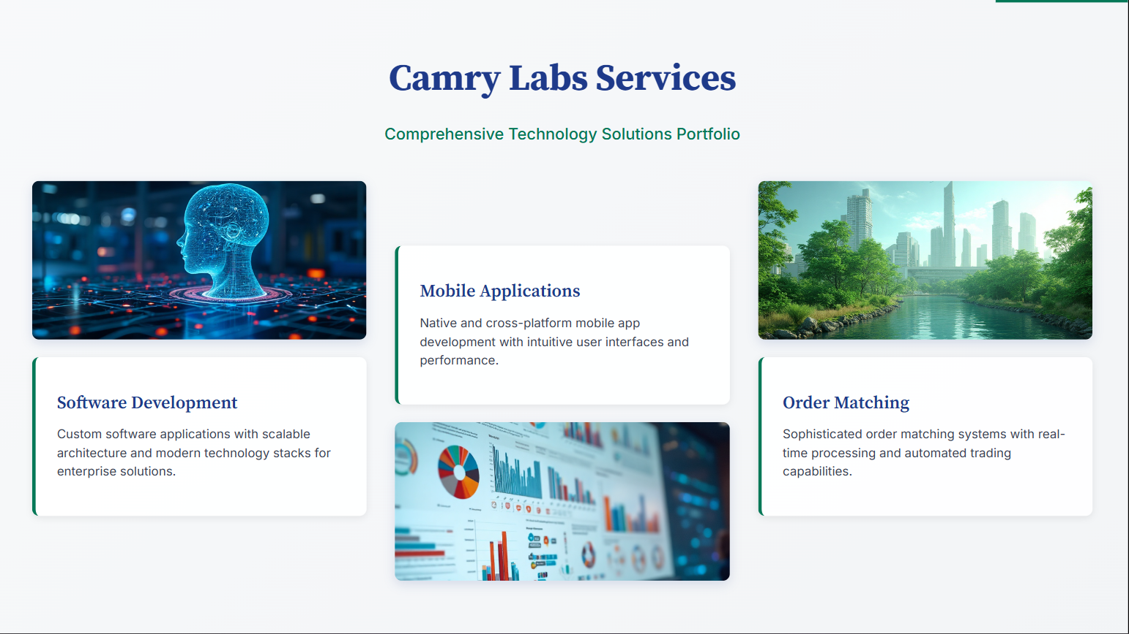

Slide 5
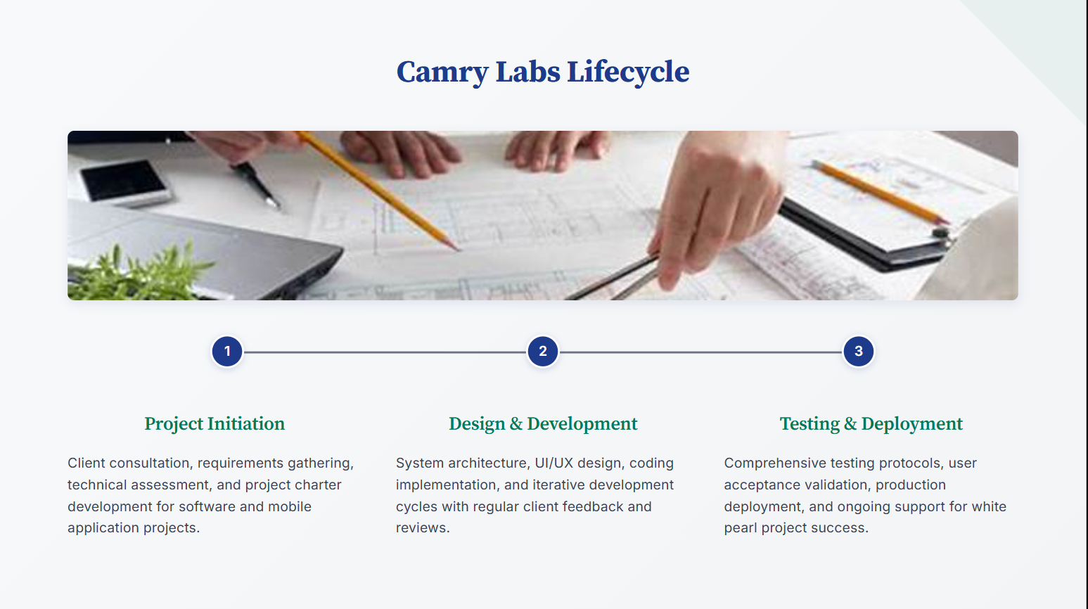

Slide 6
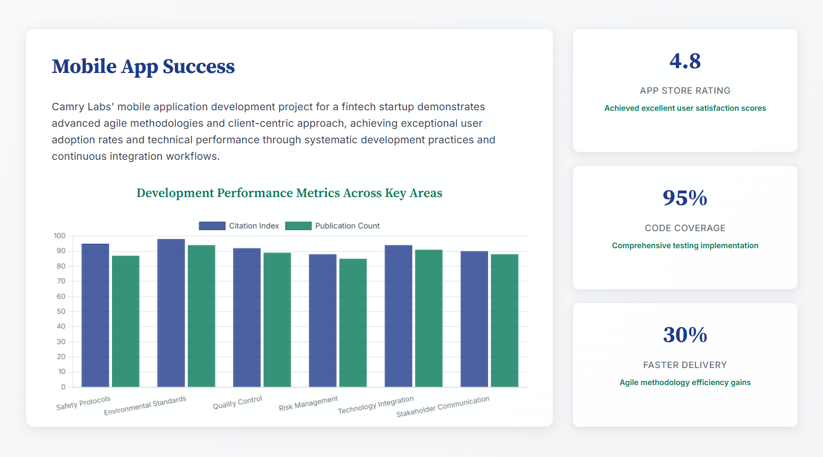

Slide 7
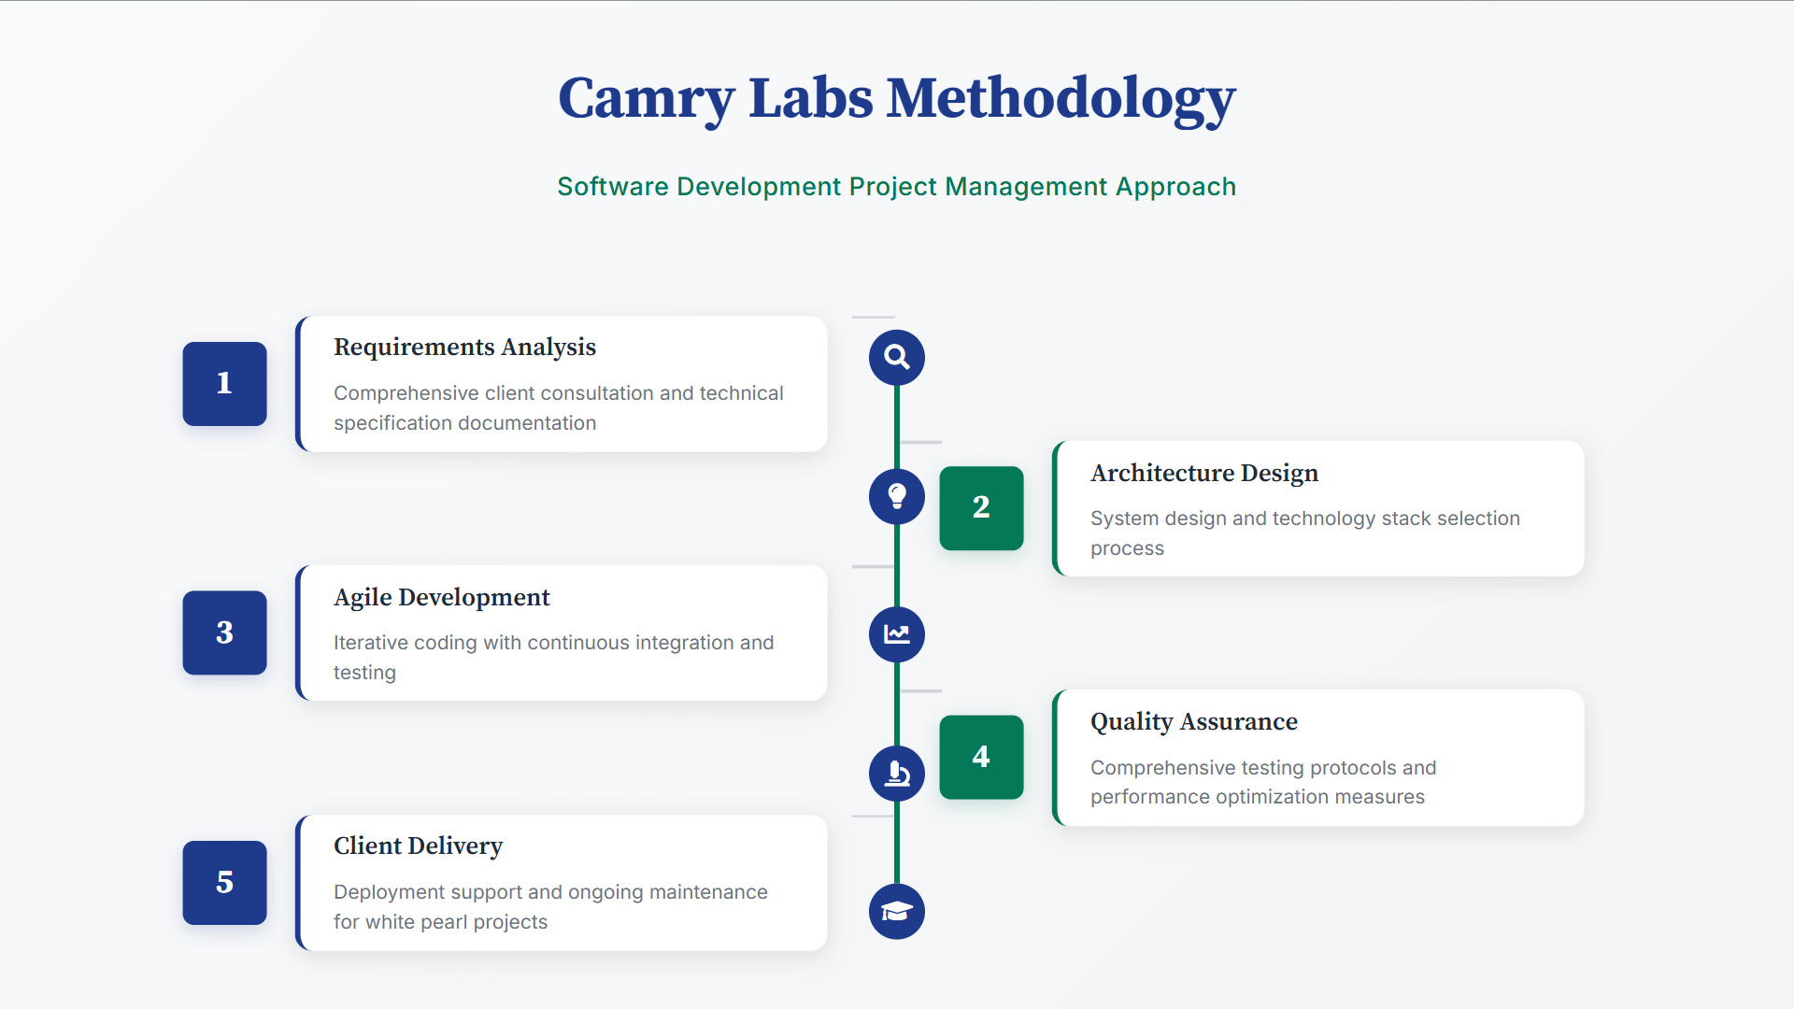

Slide 8
Thank You…
By,
Name: Prathamesh P. Barbole
Div: A , Roll No: 07
Sub: PESPM
CCE: 1
Date: 11 – 08 - 2025

